Slide 1
Software Development lifecycle
BY:- YASHRAJ NIGAM

Slide 2
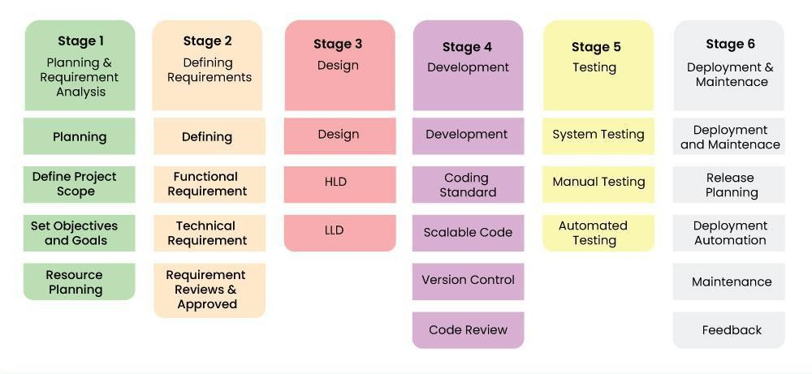
Prologue
Software development life cycle (SDLC) is a structured process that is used to design, develop, and test good-quality software.
The Following are the six stages of SDLC :-

Slide 3
Models Of SDLC and their drawbacks
Waterfall Model
Iterative Model
Inflexibility :- Difficult to accommodate changes.
Late testing :- Testing is done late in the, which lead to discovering defects at a very late stage
Resource Intensive :- Requires more resources and management attention
Complexity :- Can lead to problems with system architecture as requirements are not gathered upfront
Spiral Model
V model
Expensive: Not suitable for small projects due to high costs
Complexity: The process is complex and heavily dependent on risk analysis
Rigidity: Very rigid and inflexible, making it difficult to go back to previous stages
No Early Prototypes: Software is developed during the implementation phase.

Slide 4
Reasons to follow sdlc
Structured Process: Ensures a clear, organized approach to software development.
High Quality: Helps identify and fix issues early, leading to better software quality.
Effective Management: Facilitates tracking progress and managing resources efficiently. Risk Management: Helps identify and mitigate risks early in the development process.
Customer Satisfaction: Ensures that the final product meets user requirements and expectations.
Documentation: Provides comprehensive documentation at each stage, aiding future maintenance and upgrades.

